Slide 1
Blue & Gold
Here is where United States of Europe begins.

Slide 2
INDEX
Concepts
Conceptualization
Method
100 mill.
Methodology
Outcome
50 mill
Shaping movements
Future
Development and dimensions

Slide 3
CONECTOGRAPHY
Concepts
1960
People living in urban areas
40%
The concept of connectography is introduced as a departure from traditional divisions of the world based on nations and borders.
According to Khanna, the global connectivity revolution, spanning transportation, energy, and communications, has brought about a significant increase in the movement of people, goods, resources, and knowledge. This has blurred the lines between geography and connectivity, leading to the merging of these forces into what he terms "connectography."
2020
People living in urban areas
55%
2060
People living in urban areas
85%
Notes:
El concepto de conectografía se introduce como un alejamiento de las divisiones tradicionales del mundo basadas en naciones y fronteras. Según Khanna, la revolución mundial de la conectividad, que abarca el transporte, la energía y las comunicaciones, ha provocado un aumento significativo de la circulación de personas, bienes, recursos y conocimientos. Esto ha difuminado las fronteras entre geografía y conectividad, dando lugar a la fusión de estas fuerzas en lo que él denomina "conectografía".

Slide 4
Concepts
BLUE BANANA
The Blue Banana is a discontinuous corridor of urbanization in Western and Central Europe, with a population of around 100 million. The conceptualization of the area as a "Blue Banana" was developed in 1989 by RECLUS, a group of French geographers managed by Roger Brunet.
GOLDEN BANANA
The Golden Banana or Sun Belt is an area of higher population density lying between Cartagena in the west and Genoa in the east.
The area runs along the Mediterranean coast, and it was defined by the "Europe 2000" report from the European Commission in 1995 similarly to the Blue Banana.

Slide 5
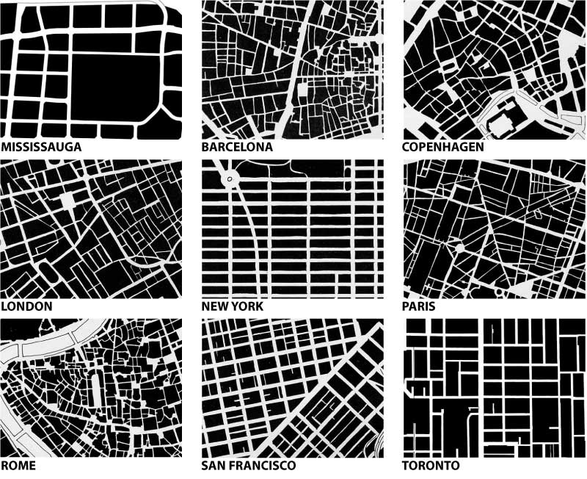
Connectography
Concepts
Enviromental Connectivity
Digital Connectivity
Economic Connectivity:
Cultural Connectivity
Political Connectivity
Shaping
Social Connectivity
Physical Infrastructure: urban grow, pipelines, cables roads…
Notes:
Además de examinar la dinámica socioeconómica dentro de la Banana Azul y la Banana de Oro, este proyecto incorpora los flujos de la conectografía para visualizar la influencia en las actividades económicas y el desarrollo regional, mediante la integración de datos.
Exploración de cuestiones conceptuales: ¿Es el plátano azul un fenómeno real? Nos adentramos en el debate en torno a la Banana Azul, examinando si constituye un pentagrama geográfico y económico real, sobre todo teniendo en cuenta la inclusión de áreas metropolitanas como Berlín y París en su marco. Objetivo del proyecto:Nuestro objetivo general es crear una plataforma de visualización interactiva que ilustre las dimensiones físicas y de conectividad de las regiones de la Banana Azul y la Banana de Oro. A través de este enfoque holístico, pretendemos descubrir patrones de desarrollo económico, flujos comerciales, intercambios culturales, patrones políticos y sociales y espacios digitales que complementen nuestra comprensión de la conectividad terrestre.

Slide 6


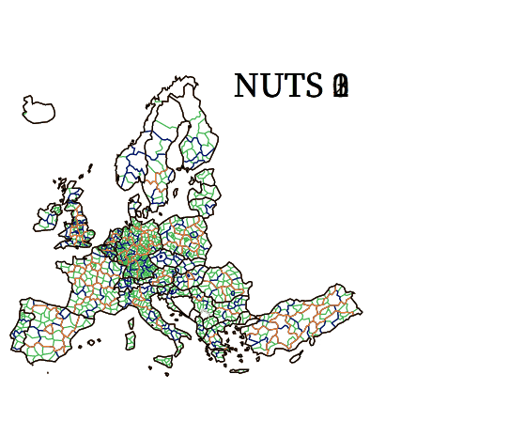
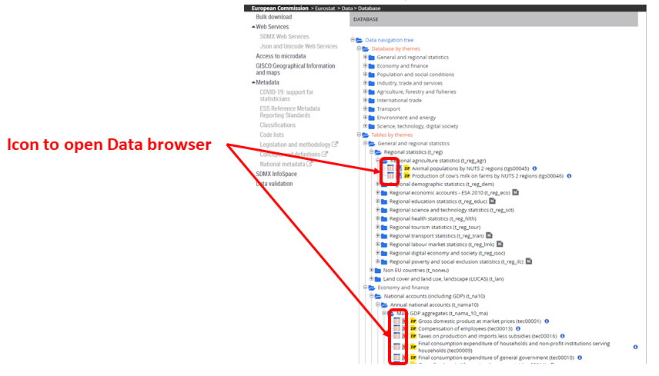

Method
Data Selection
NUTS_RG_20M_2021_3857.geojson
met_gind3
(API Client)

Slide 7
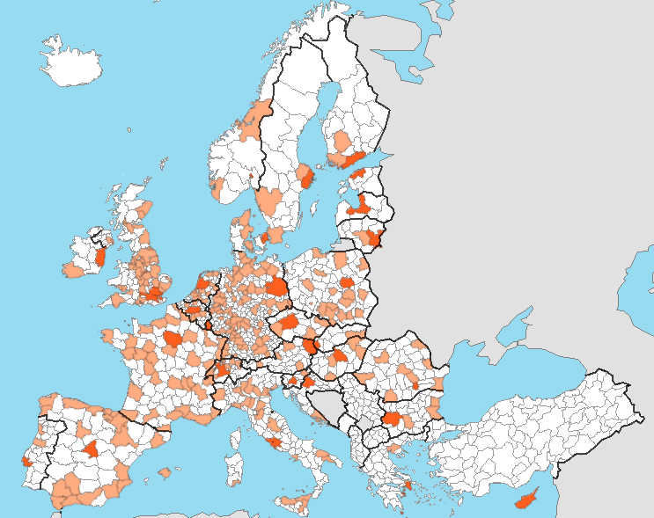
NUTS vs Metroreg vs Other Options
Method
Data Selection
NUTS
Nomenclature of Territorial Units for Statistics
Metroreg
Statistic Unit for Urban Audit
FUA
Cities and commiting territory
LAU
Land Use

Slide 8

Method
Data Transformation
METROREG
met_gind3
NUTS_RG_20M_2021_3857.geojson
Mercury is the smallest planet
LAU
Despite being red, Mars is cold
dfnut
Earth
df
Earth is the only planet with life
Sun
Moon
The Sun is the star at the center
dfcodenut
The Moon is an astronomical body
dfb
dfg

Slide 9

Method
Data Transformation
METROREG
Mercury is the smallest planet
Metroreg & NUTS3 equivalence
dfcodenut
LAU
Despite being red, Mars is cold
Earth
dfb
Earth is the only planet with life
dfbgeoblue
dfnexusnut
Sun
Moon
The Sun is the star at the center
The Moon is an astronomical body
dfg
dfggeogold

Slide 10
LAU
Despite being red, Mars is cold
Earth
Method
Data Transformation
dfbluegoldnatgrow
METROREG
Mercury is the smallest planet
Sun
Moon
The Sun is the star at the center
The Moon is an astronomical body
LAU
dfbgeoblue
Despite being red, Mars is cold
Earth
Earth is the only planet with life
dfbluegoldnatinmgrow
dfgeogoldnatgrow
Sun
Moon
The Sun is the star at the center
The Moon is an astronomical body
dfgeogoldennatinmgrow
dfgeogold

Slide 11
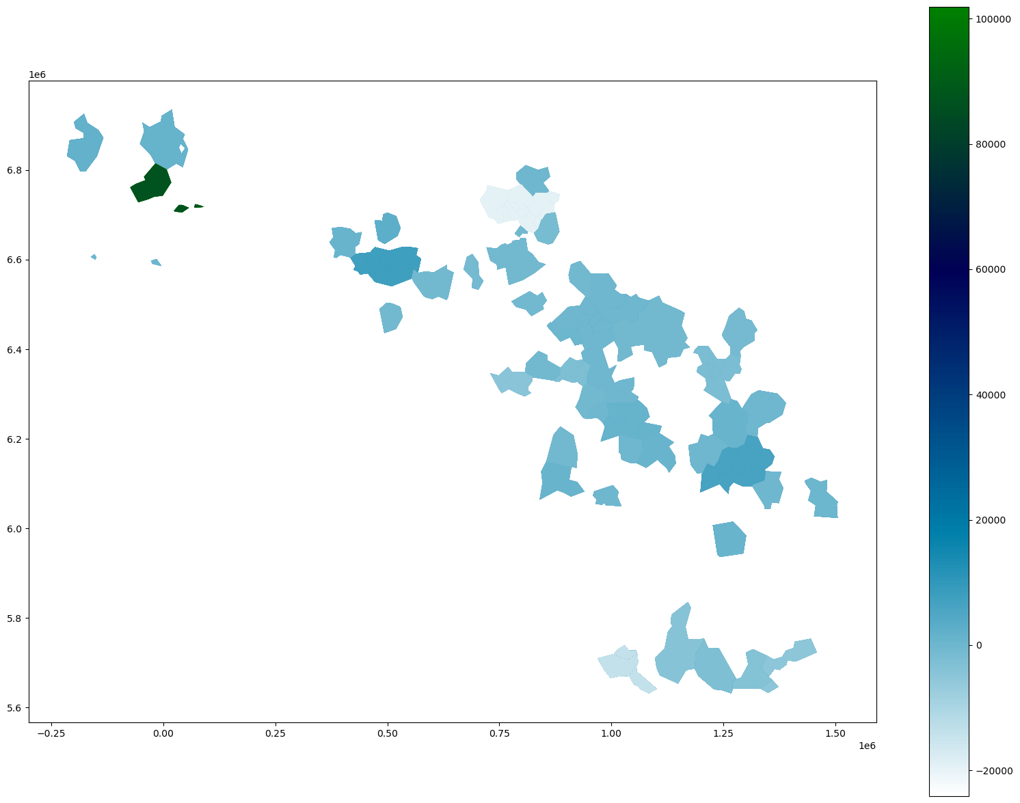
Outcome
Shaping movements
dfbluegoldnatgrow

Slide 12
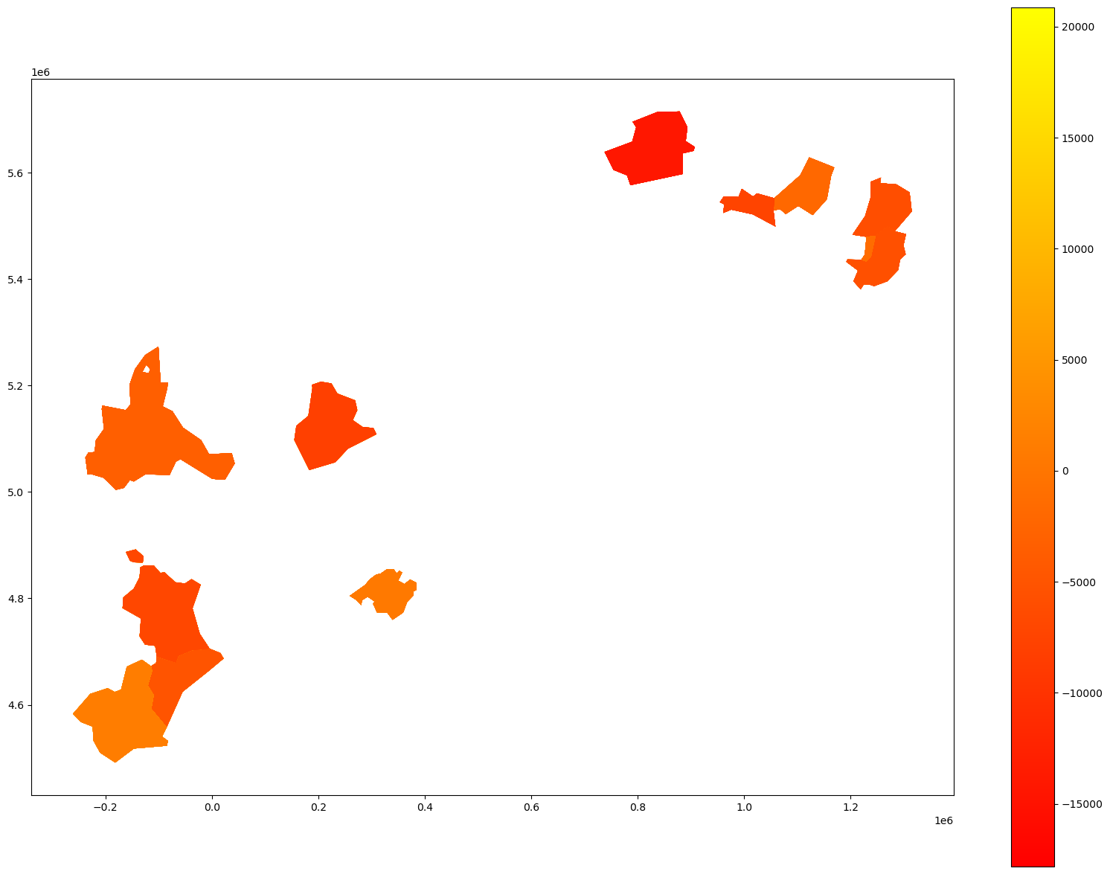
Outcome
Shaping movements
dfgeogoldnatgrow

Slide 13
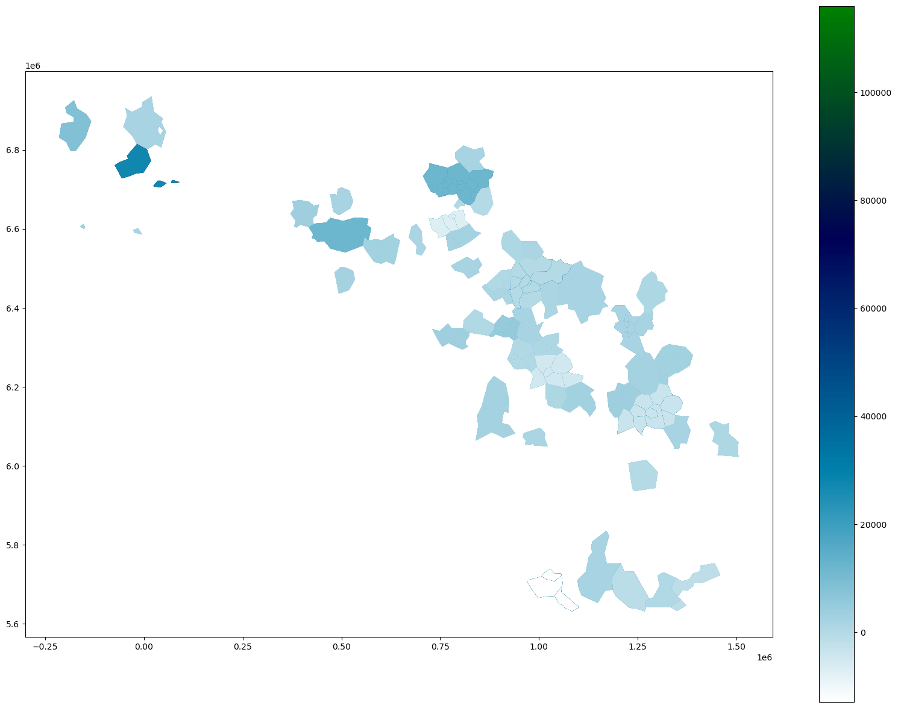
Outcome
Shaping movements
dfbluegoldnatinmgrow

Slide 14
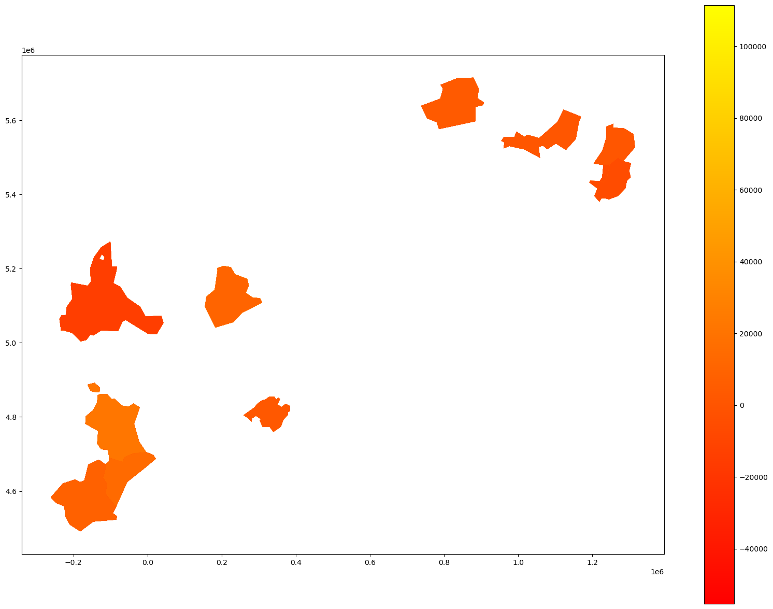
Outcome
Shaping movements
dfbluegoldnatinmgrow

Slide 15
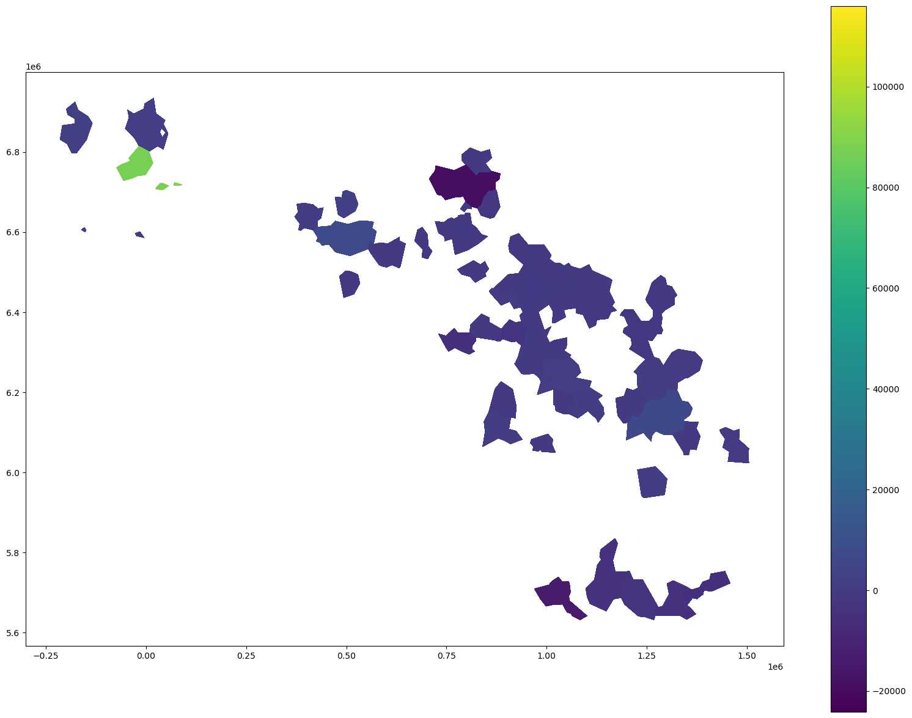
Outcome
Shaping movements
dfbgeoblue

Slide 16
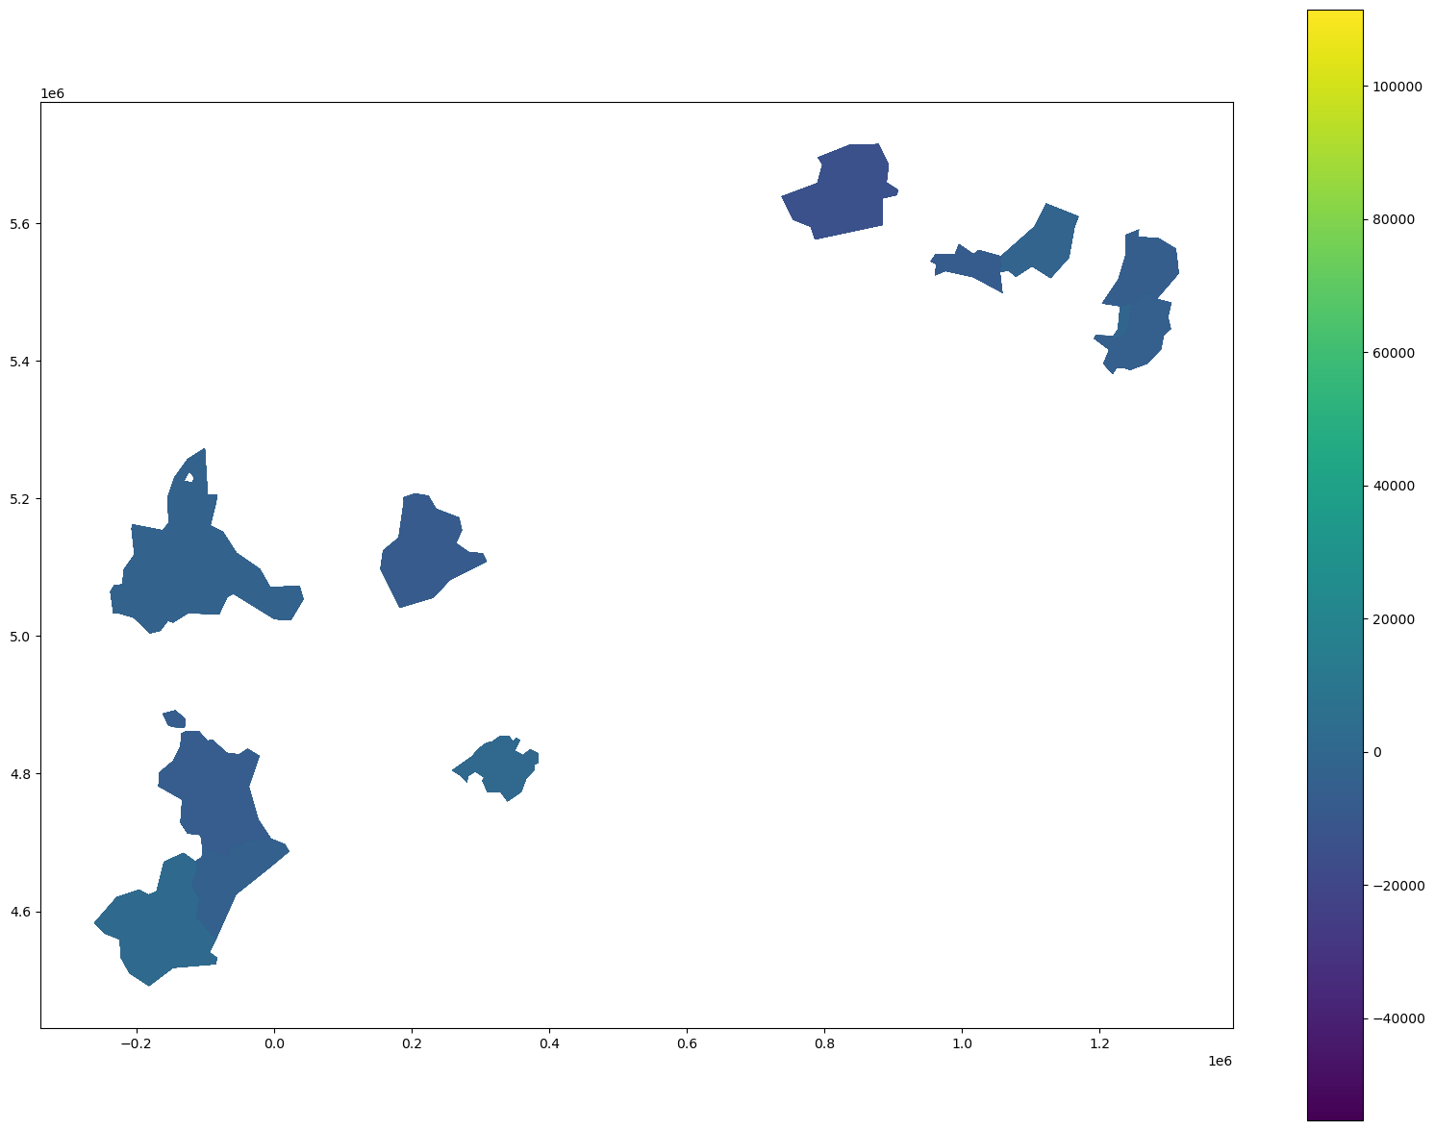
Outcome
Shaping movements
dfgeogold

Slide 17
Future
Developments
PLOTS
Geolocalization
Basic ilustration of information.
Geolocalization by Folium or Ploty Go libraries
POLIGONIZATION
BANANA’S NUTS
FUA and metreoreg
In development > MAPCHART

Slide 18
Future
Dimensions
Enviroment
Economy
Social
urb_cenv / FUA
urb_cecfi / FUA
urb_cpopstr / FUA
tepsr_sp410 / ??
met_proj / MET
Digital
Physic

Slide 19
THANKS

